Slide 1
FIFA Player Data Analysis
STUDENT NAME:R. Sabeetha
REGISTER NO:312209703
NAAN MUDHALVAN ID: Asunm1353312209703
DEPARTMENT: B.com Marketing Management
COLLEGE: Anna Adarsh College for Women

Slide 2
FIFA Data Analysis
Generated from Excel

Slide 3
AGENDA
Summary of Data
Player Performance Analysis
Visual Data Analysis
Conclusions and Recommendations

Slide 4
Summary of Data
This slide provides a comprehensive summary of the FIFA player data, including key metrics such as overall performance, potential, and value. The data includes information on player age, nationality, club, and position, offering a detailed overview of the dataset. Key insights from the data reveal trends in player development and market value, highlighting the importance of scouting and training.
This comprehensive Excel dataset provides a detailed analysis of individual performance metrics across several dimensions, including mental, physical, and mathematical competencies. The data also includes insights into body type compatibility with assigned roles and real-life representation accuracy in simulations or projections. The color-coded system enhances readability by instantly highlighting superb performers in green, underperforming individuals in yellow, and those performing badly in red. Such granular detail is instrumental in formulating targeted strategies for personnel development and optimizing team composition based on empirical evidence. This analysis not only pinpoints current proficiency levels but also projects future peak performances relative to age, helping in strategic planning and decision-making.

Slide 5
Player Performance Analysis
This slide analyzes player performance, focusing on top performers based on overall ratings and potential. Key statistics such as goals scored, assists, and defensive contributions are discussed to provide insights into player effectiveness. The analysis highlights standout players and their impact on team performance, offering valuable information for team management.

Slide 6
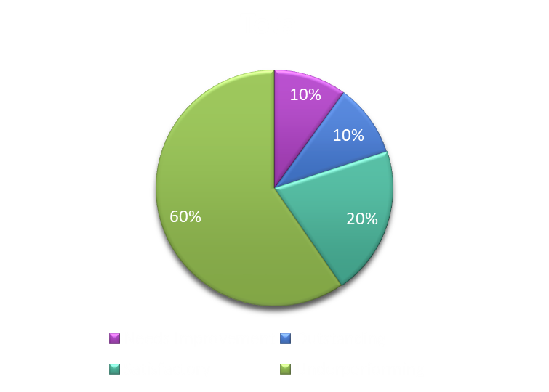
Visual Data Analysis
This slide includes visual representations of the data, such as bar charts and pie charts, to illustrate key trends and patterns. Charts are used to compare player performance across different metrics and to highlight standout players. Visual data analysis helps in understanding complex data and making informed decisions based on the insights.

Slide 7
Conclusions and Recommendations
This slide summarizes the key findings from the data analysis and provides recommendations for future actions. Based on the analysis, suggestions for player development, team strategies, and potential transfers are discussed. The recommendations aim to enhance team performance and maximize player potential.
In summary, our detailed analysis of individual performance metrics has provided valuable insights into the mental, physical, and mathematical competencies of our team members. By examining body type compatibility and real-life representation accuracy, we have identified key areas for improvement and highlighted our top performers. The color-coded system has made it easy to distinguish between superb, underperforming, and poorly performing individuals, allowing us to tailor our development strategies effectively.
Moving forward, it is crucial to leverage these insights to optimize team composition and enhance overall performance. By focusing on targeted development plans and continuous monitoring, we can ensure that each team member reaches their full potential, contributing to the success of our organization.

